Slide 1
CSRF 1 Lab

Slide 2
CSRF 1 Lab
Materials needed
Kali Linux Virtual Machine
Windows 7 Virtual Machine
Software tool used
DVWA (Web Application)

Slide 3
Objectives Covered
Security+ Objectives (SY0-501)
Objective 1.2 – Compare and contrast types of attacks
Application/service attacks
Cross-site request forgery
DHS CAE Units
CTH – Describe different types of attacks and their characteristics

Slide 4
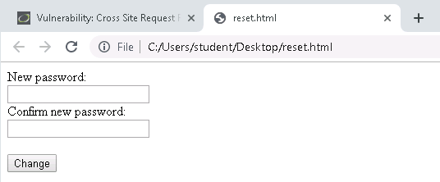
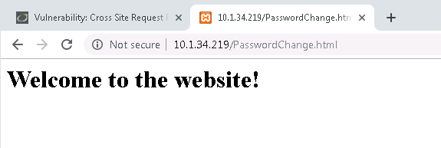
What is a CSRF Attack?
Cross-Site Request Forgery (CSRF or XSRF) attacks hijack and reuse requests from an authenticated user
Can be transmitted via an image tag, HTTP requests, hidden requests, etc.
User rarely has any idea the attack/request has even happened
An attacker can change log-in credentials, transfer ownership, gain access to private data, transfer money or resources, etc.

Slide 5
The CSRF Lab
Setup Environments
Find Kali’s IP Address
Log into DVWA
Change the Password
Create New Request Form
Play the Victim

Slide 6
Setup Environments
Log into your range
Open the Kali Linux and Windows 7 Environments
You should be on your Kali Linux Desktop
You should also be on your Windows 7 Desktop

Slide 7

Find Kali’s IP Address
You will need the IP address of the Kali machine
Open the Terminal
In the Linux VM, open the Terminal and type the following command:
hostname -I
This will display the IP Address
Write down the Kali VM IP address
The IP Address

Slide 8
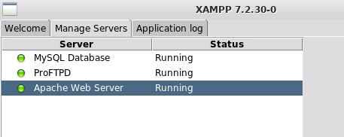
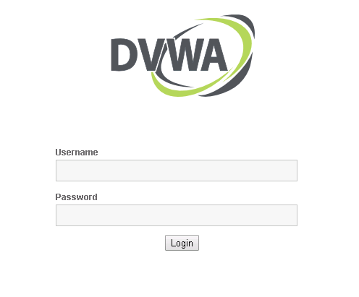
Log into DVWA
Start up the web servers (on the Kali machine)
If you used the DVWA Setup Lab, use the following command to start XAMPP (then start/restart all the servers):
sudo /opt/lampp/./manager-linux-x64.run
On the Windows Machine, go to the DVWA webpage
http://<Kali-IP-Address>/dvwa
Login credentials are admin/password

Slide 9
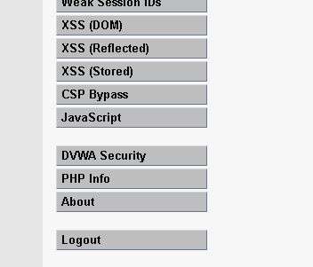
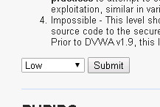
Log into DVWA
Login using the following credentials
Username: “admin”
Password: “password”
Click on the “DVWA Security” option
Change the Security Level to Low
Select Submit
This lowers the DVWA security to the lowest setting
DVWA Security option
Set to Low

Slide 10
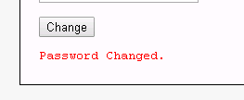
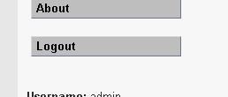
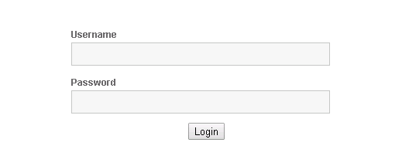
Change the Password
Password changed notification
Click on the CSRF option
Here, you can change the password
Reset the password (don’t forget it!!)**
You will receive a “password changed” notification
Logout of DVWA
Log back in using “admin” and the new password
Click to logout
**If at any point you forget the password, go here:
www.<Kali-IP-Address>/dvwa/setup.php
Click “Create/Reset Database” to reset password
Log back in with new password

Slide 11
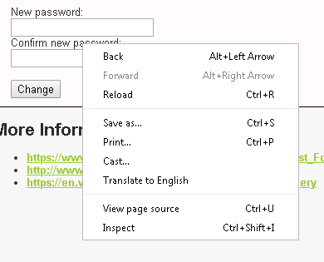
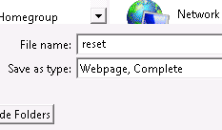

Create New Request Form
Stay in the same browser (Windows machine)
In DVWA, go to the CSRF option
Save the webpage to the Desktop
Right-click on the page
Select “Save as…”
Save to the Desktop as “reset”
You should see a “reset” appear on the Desktop
Click “Save as…”
Name as reset
Webpage on the Desktop

Slide 12
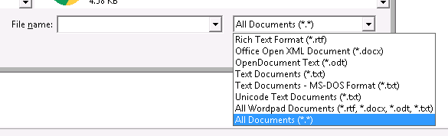
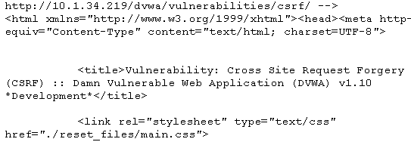
Create New Request Form
Open the webpage in a text editor (like WordPad)
Open Wordpad
In WordPad, “open” a file
Navigate to the Desktop
Change file options to “All Documents”
Select the “reset.html” file
This will open the html file
Read through the HTML, try to find where the password is being reset
Change to
All Documents
Webpage open as a text file in WordPad

Slide 13
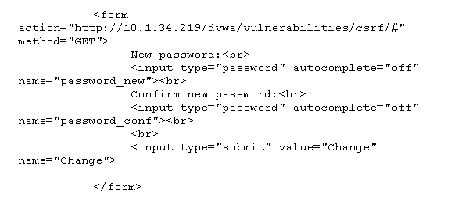
Create New Request Form
The password is being reset in a form, navigate to this form
Delete everything else from the HTML except this form

Slide 14
Create New Request Form
Save the new HTML File (after deleting everything but the form)
Open the webpage in the browser (from the Desktop)
You should see a webpage like the following appear
If this is completed, this will change the password (feel free to try)
Let’s start to get rid of the user input so the password automatically changes

Slide 15
Create New Request Form
In the text editor, get rid of all the text and line breaks from the webpage
Delete the parts in red and crossed out (example)
<form action="http://10.1.34.219/dvwa/vulnerabilities/csrf/#" method="GET">
New password:<br>
<input type="password" autocomplete="off" name="password_new"><br>
Confirm new password:<br>
<input type="password" autocomplete="off" name="password_conf"><br>
<br>
<input type="submit" value="Change" name="Change">
</form>

Slide 16
Create New Request Form
Now, hide the inputs and automatically submit a value for these
Also, change the texts for the button to “Click Here!!”
Changes are shown in red text
<form action="http://10.1.34.219/dvwa/vulnerabilities/csrf/#" method="GET">
<input type="hidden" autocomplete="off" name="password_new" value="passwordNew">
<input type="hidden" autocomplete="off" name="password_conf" value="passwordNew">
<input type="submit" value="Click Here!!" name="Change">
</form>
Here, the new password will be “passwordNew”, this can be set to anything

Slide 17
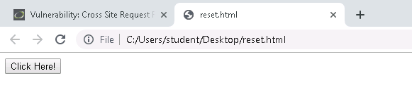
Playing the Victim
Save the file
Open the webpage by selecting the “reset” on the Desktop
You should see a website with just a “Click Here!!” button
Click on the button**
You should notice it takes you back to the CSRF tab
Notice it says “Password Changed”
Click the Button
**Make sure you are logged into DVWA on another tab

Slide 18
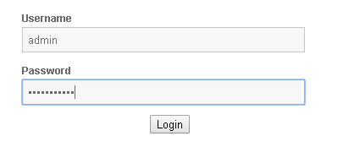
Playing the Victim
Logout of DVWA
Log back in
You should notice the credentials are
Username: admin
Password: passwordNew
The password was changed by having the user only click one button

Slide 19
Defend Against CSRF Attacks
Do not leave sessions opened
This attack would not have happened if the user was not logged into the DVWA website application on the other tab
Use SameSite Cookies
Don’t allow cookies to be used on external websites
Verify the origin of the request
Determine where the request is coming from
What are some other ways of defending against a CSRF attack?

